Slide 1
In
Investor Presentation
June 2016
David Joseph, President and CEO
© Avisa Pharma Inc.
Address: 1660A Old Pecos Trail, Santa Fe, NM 87505
490 Lapp Road, Malvern, PA 19355
Work: (505) 820-1400 | Cell: (484) 459-5076 | Fax: (505) 226-1500
Email: dsj@avisapharma.com | Website: www.avisapharma.com

Slide 2
    One Third of Outpatient Antibiotic Rxs May Be Inappropriate
      Medscape Medical News, May 3, 2016
    Diagnosis Problems Blamed for 30-fold Overuse of MRSA Drugs
      Medscape Medical News, June 16, 2016

Slide 3
Avisa – Company Overview
Clinical-Stage Healthcare Diagnostic Company
  Commercializing a rapid, point-of-care breath test for the diagnosis of pulmonary infections
Competitive Advantages
  Large markets with multiple, complimentary indications
  Safe, understood technology applied in a novel way
  Strong IP position with patents issued and expansions underway
  Successful human pilot studies already completed
  Clear regulatory pathway requiring short trials with no follow up
  Existing reimbursement (CPT) codes
  Experienced management team with multiple successful exits
  Cost advantaged product is a win for patient, doctor, hospital and payer

Slide 4
The Avisa Team – Management
David Joseph President & CEO Co-Founder | 40+ yrs of experience commercializing medical devices and pharmaceuticals Co-founder of four life science companies with successful exits (IPO, M&A) Multiple past and present board positions
Elizabeth Perkett, MD Chief Medical Officer | Professor of Pediatrics specializing in pulmonary medicine, Vanderbilt Univ Over 50 recent scientific and clinical publications Cystic Fibrosis Foundation committee member
David Karshmer SVP, Product Development | 20+ yrs of experience in medical device design Founded IDEO Healthcare practice, developed numerous medical products Successful serial entrepreneur (Avisa is 6th start-up company)
John Maynard VP, Engineering | 20+ yrs experience developing medical devices based on spectroscopy VP of Product Development, Engineering at VeraLight and InLight Solutions 19 US patents and over 20 scientific publications
Matt Culler VP, Finance | 10+ yrs investment and financial management experience VP of Finance (and acting CFO) at xF Technologies Venture Capital and Investment Banking experience
Graham Timmins, PhD Chief Science Advisor | Associate Professor of Medicinal Chemistry at the University of New Mexico Co-inventor of the Company’s patent portfolio Author/co-author of over 50 publications and recipient of several federal grants

Slide 5
The Avisa Team – Scientific Advisory Board
William Bishai, MD/PhD | Professor of Medicine, Co-Director, Center for Tuberculosis Research Dept. Div. of Infectious Diseases, Johns Hopkins School of Medicine, Baltimore, MD
Ann C. Halbower, MD | Associate Professor, Pediatric Pulmonology, The Children’s Hospital and University of Colorado Health Sciences Center, The Children’s Hospital Sleep Center, Aurora, CO
Kevin Harrod, PhD | Benjamin Monroe Carraway Endowed Chair and Professor, Department of Anesthesiology and Perioperative Medicine, School of Medicine | University of Alabama at Birmingham
Richard Lee, PhD | Member, St. Jude Faculty, Chemical Biology & Therapeutics, Adjunct Professor, UT Health Science Center, Departments Chemical Biology & Therapeutics, St. Jude Children's Research Hospital, Memphis, TN
Todd Rice, MD/MSc | Assistant Professor of Medicine, Vanderbilt University School of Medicine, Nashville, Tennessee, Associate Director, Medical Intensive Care Unit, Vanderbilt University Hospital, Nashville, TN
Andrew Shorr, MD/MPH/FACP/FCCP | Director, Medical Intensive Care Unit, Assoc. Director Pulmonary and Critical Care Medicine Medstar Washington Hospital Center, Washington, DC
Gerard Criner, MD | Chairman, Thoracic, Pulmonary and Critical Care, Temple University Hospital, Philadelphia, PA

Slide 6
Problem: Pulmonary Infection Stewardship
Pulmonary Infections are Frequent but Vary Meaningfully in Severity and Appropriate Treatment
  Segregating pulmonary infections based on urease reactivity provides meaningful clinical information to physicians
Currently, No Effective Urease Assays Exist
  Cultures are best available but are insensitive and take days
  Therefore, patients are treated empirically with varied results
Major Consequences
  High of cost of care (unnecessary admissions, misdiagnosis)
  Overuse of expensive antibiotics causing multi-drug resistance
  Reimbursement loss to healthcare facilities

Slide 7
Market – Pneumonia in Emergency Depts
Pneumonia is a Leading Killer and Costs Billions
  5.6MM cases in U.S. alone (costing >$17B annually)
    3 million cases at emergency departments
  Admission to ICU in 10-20% of cases ($4,000 cost/day)
Urease Positive (U+) Pathogens Lead to High Cost Cases
  U+ pathogens include staph, pseudomonas, klebsiella, etc
  U+ pathogens are responsible for 82% of healthcare associated cases
  U+ pathogens are responsible for 10% of community acquired cases
    U+ pathogens are responsible for 61% requiring ICU admission

Slide 8
Market – Pneumonia in Ventilators
Pneumonia is a Major Problem in Ventilated Patients
  1.7MM patients in U.S. ICUs are placed on ventilator
  22.8% of ventilated patients get pneumonia (~400,000 in U.S.)
Urease Positive (U+) Pathogens Lead to High Cost Cases
  U+ pathogens include staph, pseudomonas, klebsiella, etc
  U+ pathogens are responsible for 70% of ventilator associated cases

Slide 9
Strategy – Initial Target Markets
U.S. Pneumonia Market
Pneumonia
in ED
1 test each
(@$150/test)
$346MM
41%
Community
Acquired
2.3MM cases
90%
5.6MM cases
59%
Pneumonia
at GP/UC
Pneumonia
3.3MM cases
U.S.
$1.7B
(3.0MM cases)
6.2MM cases
Ventilator
Associated
4 test each
(@$200/test)
$1.3B
58%
10%
Hospital
Acquired
0.4MM cases
(1.7MM vent patients)
0.6MM cases
Hospital
(Non-Vent)
1 test each
(@$150/test)
$40MM
42%
0.3MM cases
EU: $1.4B (8.2MM cases)
China: $3.4B (50MM cases)

Slide 10
Clinical – Pneumonia
Pneumonia in the ED Pilot Study
  Protocol complete
    Protocol title: A Phase 1, open-label, multi-center evaluation of AV-U13 in the detection of urease producing bacteria in patients diagnosed with pneumonia in the emergency department
    50 Subjects across 3 sites
    Name of Sponsor: Justin T Baca, MD, PhD (UNM)
    Additional Sites – Philadelphia, Boston
  Waiting for FDA approval
  Study targeted for Sep-Dec 2016 (with interim data available late 2016)
VAP Pilot Study
  Protocol being developed
  Study targeted for Jan-Jun 2017

Slide 11
Clinical – Other Studies
Temple University COPD Pilot Study
  Name of Sponsor: Dr. Gerry Criner, PI
  Protocol: Does mouth bacterial contribute to COPD exacerbations?
    30 patients (Smokers, Non Smoker and Controls)
    13c urea mouth rinse followed by breath capture
    50% complete, abstract for ATS due in Aug/Sep on interim results
South Africa TB Extension Study
  Enrollment complete, awaiting final culture report
  More HIV+ patients than earlier trial
  Mouth rinse at zero post nebulization mitigate mouth and TB signal
  No mouth rinse, interim showed similar results as earlier trial

Slide 12
Clinical Validation
Pseudomonas in Cystic Fibrosis
  Proof of Concept Study (2014)
    Safety & efficacy demonstrated
    Compared 20 and 50 mg doses
    6 subjects (3 with infection)
  Pilot: HCAP in ER (beginning in Q3)
Tuberculosis (TB)
  Proof of Concept Study (2015)
    29 subjects (21 with TB)
    Safety & efficacy demonstrated
  Extending study to optimize nebulization and breath collection

Slide 13
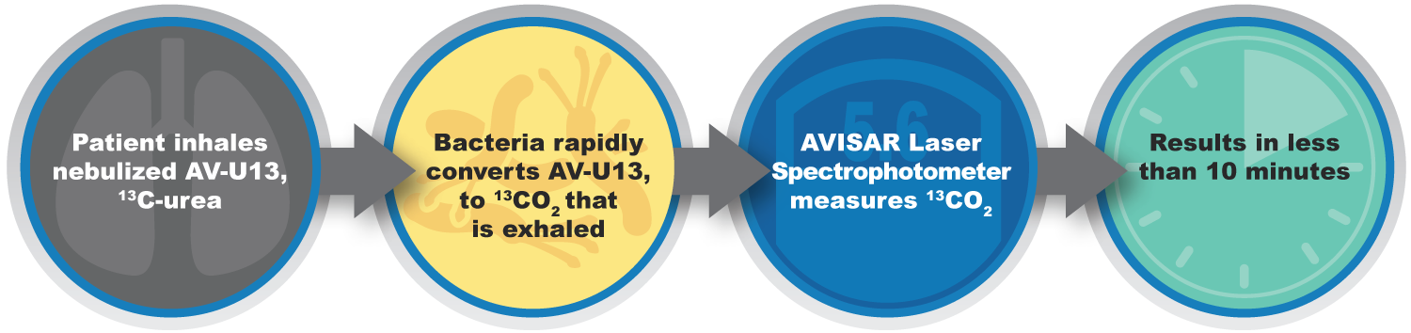
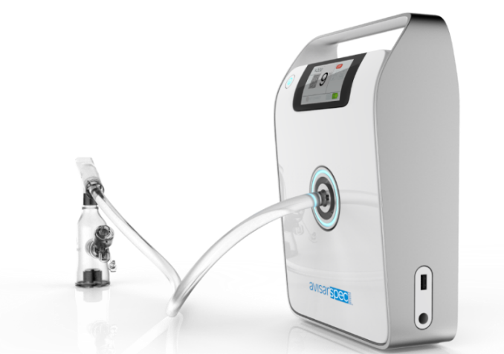

The Avisa Platform Technology
Simple, Inexpensive System to Measure the Whole Lung
  10 minute breath test leverages existing agents and technology
Agent: AV-U13 (¹³C-urea)
  Safe, non-radioactive, stable
Device: AVISARTM
  Laser spectrometer w/ nebulizer

Slide 14
Avisa Platform Advantages
Speed
  Rapid detection (less than 10 minutes, start to finish)
Reliability
  Accurate and repeatable measurements
Ease of Use
  Simple to Operate with single use disposable kit
Flexible
  Operable from rural developing country settings to modern hospitals
Cost
  Lowers overall expense for patients, hospitals, and payers

Slide 15
Intellectual Property
Broad Intellectual Property Protection
Biomarkers
  Two core patents issued for P. aruginosa and TB
  Broadening reissued patent expands to cover all urease pathogens
  Four patents pending and new filings
AVISAR
  Four patents pending and new filings

Slide 16

Commercialization Timeline
2012-2015
2016
2017
2018
2019
2020+
Product Development
AVISAR
v 1-4
v5
vFlex
P Batch
R Batch
AV-U13
TOX
Clinical & Regulatory
Pneu for
ED
Proof of Concept
Pilot
…
U.S. Pivotal
FDA
Pneu for
Ventilator
Pilot
U.S. Pivotal
FDA
TB in China
if Partner $
Pilots
China Development & Trials
Financing
Series A & A-1
Series B
Series C

Slide 17
Business Model & Unit Economics
Business Model
  Sell kits
  Razor/Razorblade
Unit Economics
  AVISAR Unit: $20,000 (<$5,000 COGS)
  Disposable Test: $140 CPT Code (<$40 COGS)

Slide 18
Strategy – Initial Market Commercialization
Assumes Just 2 U.S. Products: Pneumonia in the ED and VAP
Penetration (2030): Hospital 48%; ED Cases 36%; Vent Cases 48%

Slide 19
Finance – Series B Sources and Uses
Sources
  New equity: $15.0 million
  Venture debt: $3.0 million
Uses
  Clinical & Regulatory: $4.7 million ($3 million for HCAP pivotal)
  Product Development: $6.9 million
    Drug: $2.2 million
    AVISAR: $4.7 million ($4 million for Flex)
  Overhead: $6.9 million
    Personnel: $4.9 million
    Other Overhead: $2.0 million
Syndicate
  Seeking lead and co-investors
  Significant insider participation

Slide 20
Thank You
This presentation is not to be distributed or reproduced without the express permission of the Company. It is to be used solely for the purpose of evaluating a potential investment in Avisa Pharma.
Address: 1660A Old Pecos Trail, Santa Fe, NM 87505
490 Lapp Road, Malvern, PA 19355
Work: (505) 820-1400 | Cell: (484) 459-5076 | Fax: (505) 226-1500
Email: dsj@avisapharma.com | Website: www.avisapharma.com

