Slide 1
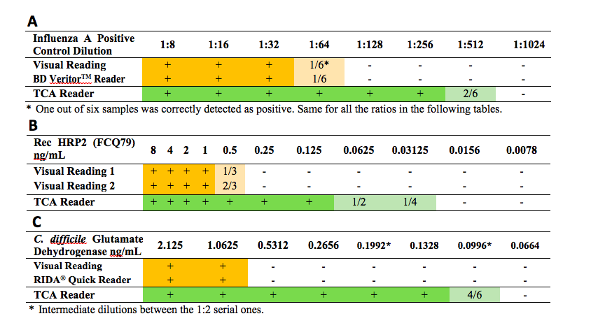
Malaria recombinant HRP2 in blood with First Response® LFAs: (Graph) Quantitative read; (Table) Qualitative read.
Wang ACS Anal. Chem. (In Preparation) 2016

